Slide 1
Photographs of Project Construction

Slide 2
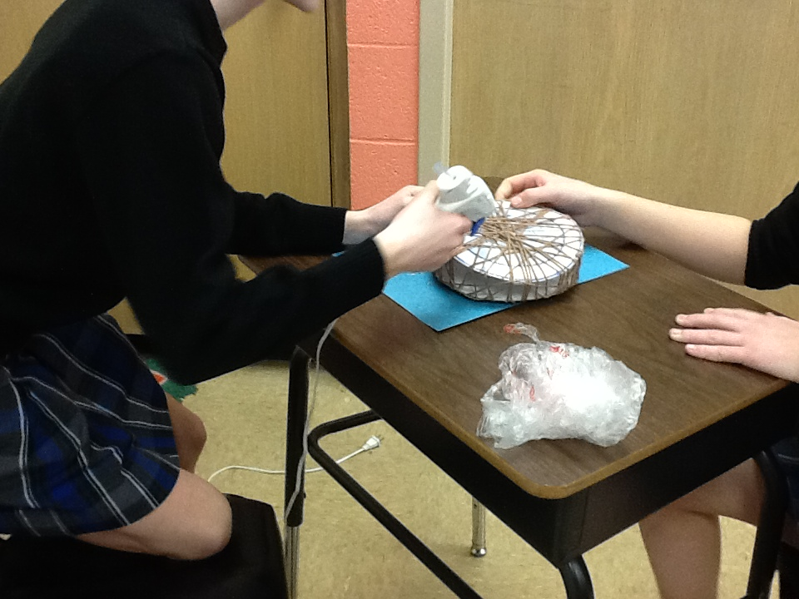
Notes:
Constructing Beijing stadium for “Modern China.”

Slide 3
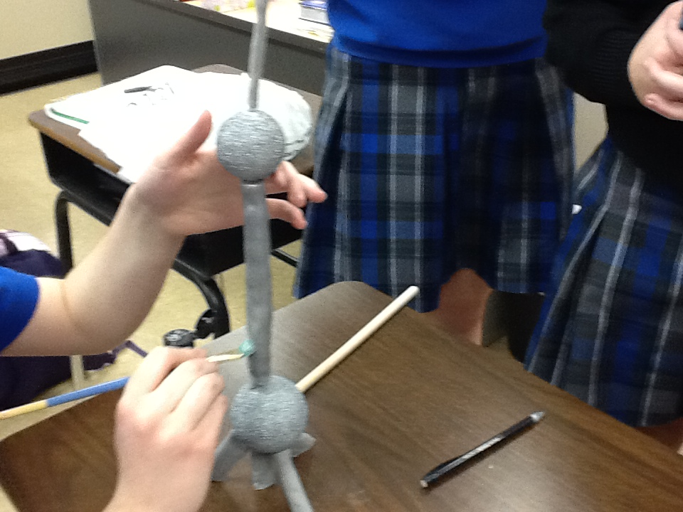
Notes:
Constructing radio tower for “Modern China”

Slide 4
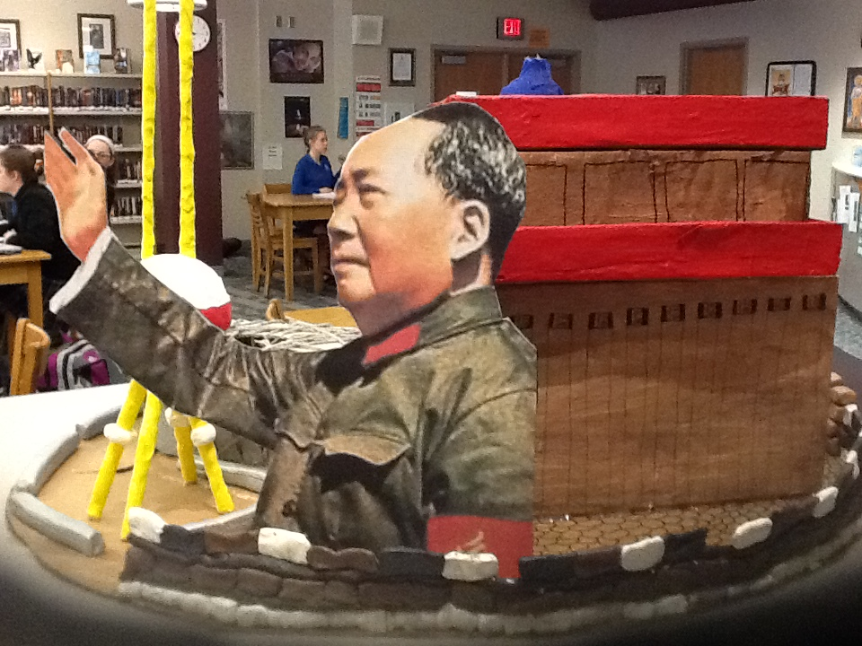
Notes:
“Mao”

Slide 5
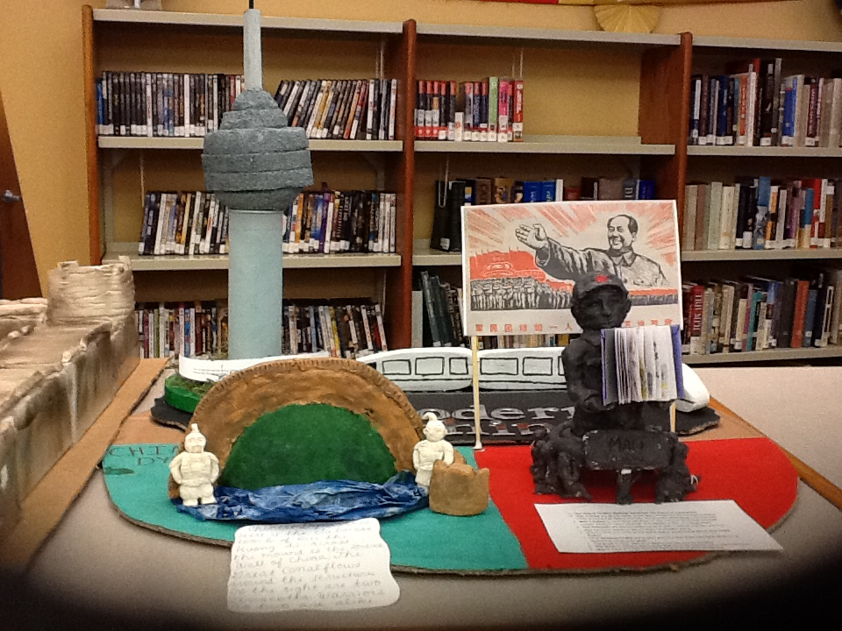
Notes:
All three “artifacts” combined: Dynasties, Mao, Modern China

Slide 6
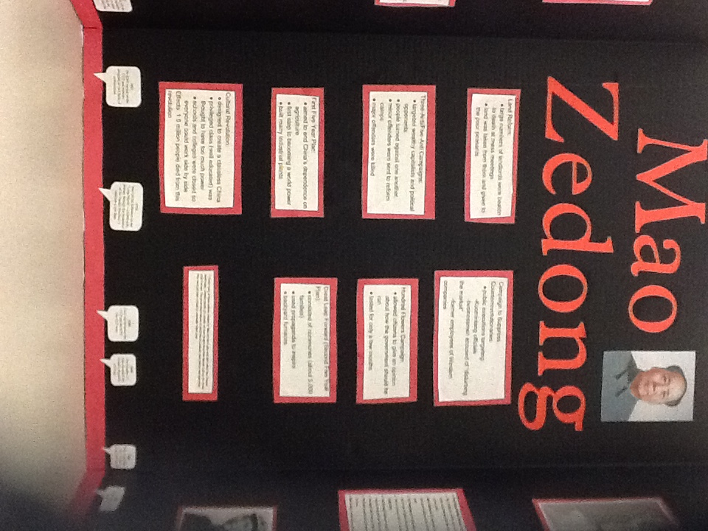
Notes:
Display board for Mao

Slide 7
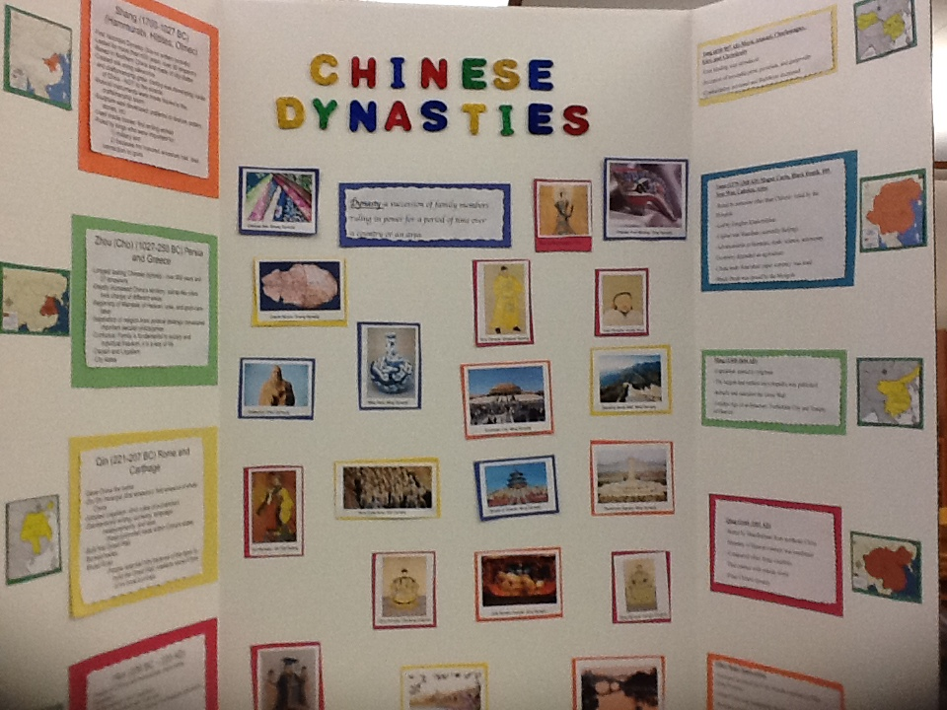
Notes:
Display board for Dynasties

Slide 8
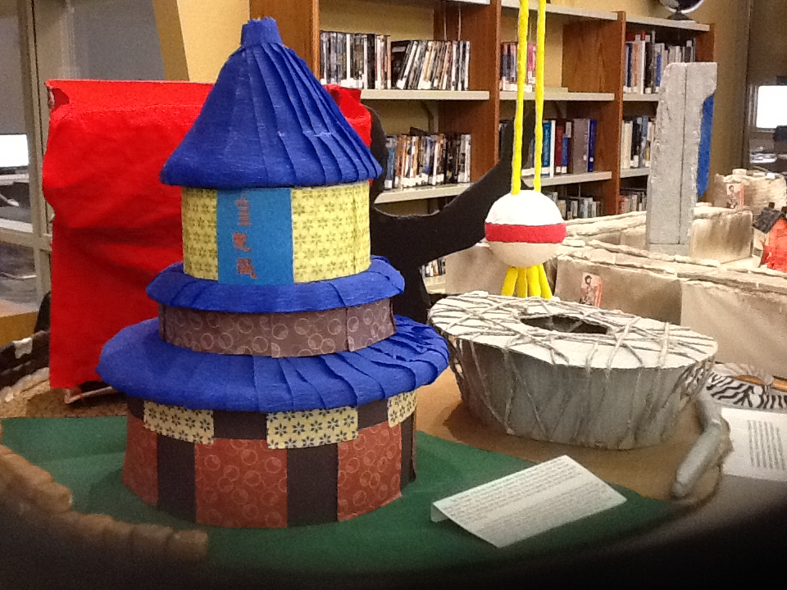
Notes:
Combined artifacts for the final project

