Slide 1
Images of China
NCTA-Zhejiang University Summer Residential Program July 2012, Hangzhou and Beyond

Slide 2
Migrant Workers’ Housing

Slide 3
Chinese Migrant Workers’ at Home

Slide 4
Chinese Migrant Workers’ Exodus

Slide 5
Migrant Workers’ Children Scavengers at Dump

Slide 6
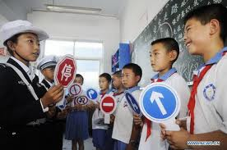
Safety Lessons in Hangzhou Migrant Center

Slide 7
Children at the Migrant Center

Slide 8
Middle and Upper Class Children Enroll in English Language Schools

Slide 9
After School English

Slide 10
Affluent Chinese Students Preparing Essays for Competition

Slide 11
English Acquisition: A Key to Success and Advancement

Slide 12
Private School Boom

Slide 13
Rising Expectations

Slide 14
China’s Cultural Traditions in the Classroom

Slide 15
Emphasis on Rote Learning

Slide 16
Rote-Learning, Uniforms, and High Expectations

Slide 17
Hangzhou Reminders for Citizens:

Slide 24
Not such a bad idea???

