Slide 1
China’s Dynasties
Part II

Slide 2
Song (969-1279AD) (Crusades, Inca)
Magnetic compass, growing sea power-large ships--rudder, steel, gun powder
Scientists recorded the crab-nebula explode in 1054
Civil-service tests: the best for government positions.
Water & waste management
Credit system: "flying money" redeemed for coins
Foot-binding increased--subordination

Slide 3
Song Dynasty

Slide 4
Song Dynasty Program in Hangzhou

Slide 5
Song Dynasty Program in Hangzhou

Slide 6
Yuan (Mongols) (1279-1368 AD) (Magna Carta, Black Death, 100 year War, Cahokia, Aztec)
Mongol Khublai Khan conquers China: Pastoral people!
•China more open to trade and travel (MarcoPolo)
Polo's travels created European desires to travel to China
More trade: Plague

Slide 8
Kublai Khan

Slide 9
Marco Polo: Trusted by Kublai Kahn

Slide 10
Marco Polo’s Travels

Slide 11
Yuan Dynasty

Slide 12
The Fall of the Yuan
Court became corrupt
Years of famine
1367 rebel army captured the capital
Legacy: Unification of north and south China
Waterwheels and Ironworks
Communication increases

Slide 13
Ming (1368-1644 AD)
Tried to erase all signs of Mongols
Eunuchs play growing role (Zheng He)-resented by scholar gentry
Rebuilt and extended Great Wall

Slide 15
Ming begin construction of the Forbidden City

Slide 16
Forbidden City

Slide 17
Ming Dynasty
Printing & literacy increases: woodblock printing and cheap paper
Expansion of ideas : Painting, ceramics, literature
The commercial market becomes popular

Slide 18
Emperor Zhu Di

Slide 19
Zheng He: 1371-1435

Slide 20
Zheng He / Columbus
Each ship was 400' long and 160' wide
"Treasure Fleet"

Slide 21
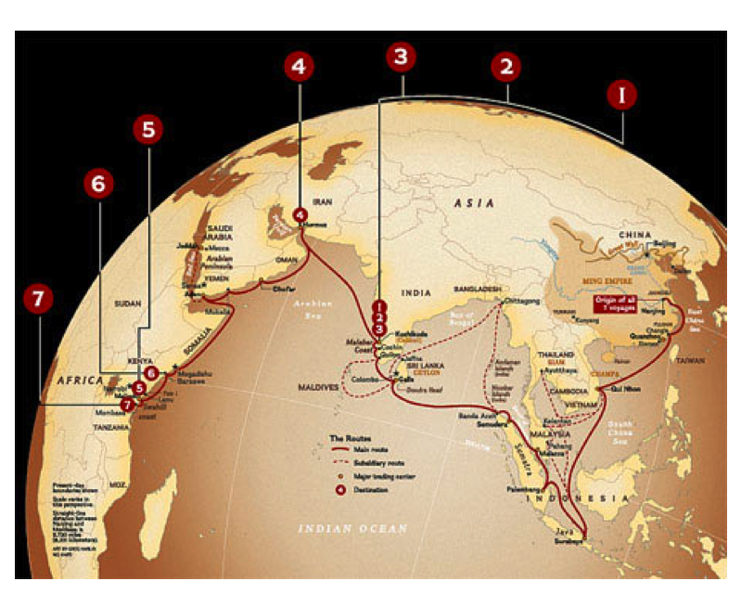
1. 1405-1407 317 ships, 27,870 men
2. 1407-1409
3. 1409-1411
4. 1413-1415
5. 1417-1419
5. 1421-1422
6. 1431-1433
7. 1433-

Slide 22
Qing (1644-1911AD)
Manchus (from Manchuria)move south
•Take Korea, Japan, Mongolia, Tibet
•Would be final Chinese Dynasty
•Eventually would be weakened by European/American interventions

Slide 23
Qing

Slide 24
Qing Dynasty
Most important aspect of the Qing was the contact with the outside world
Mostly isolated
Contact with the West brings about modernization and conflict

Slide 25
Qing Dynasty
England and America desire tea
East India Trading Company was the middle man between England and China
China was not interested in trading

Slide 26
Qing Dynasty
India imported opium illegally from India to China
People became addicted to opium so the demand for the drug increased
Opium Wars (1839-1842) were between the English and the Chinese. The Chinese were defeated, and opium continued to destroy the fabric of Chinese society

Slide 27
Qing
As a result, China signed off on Unequal Treaties, declaring that England had the ability to set the price and quantity of trade items
Protectorate states were established
Germany took over Changdu; Portugal took Macau

Slide 28
Qing
The Qing Dynasty faced many revolts from discontented people
The first was the Taiping Rebellion

Slide 29
Taiping Rebellion
Taking place in southern China from 1850-1864
Leader, Hong Xiuquan, believed he was the brother of Jesus
Established the Taiping Heavenly Kingdom; capital was Nanjing
Fought for equality, and a common Christian religion
Qing dynasty crushed the rebellion with help from British and French
Approximately 20 million died

Slide 30
Boxer Rebellion
Known as “The Righteous and Harmonious Society Movement”
Rebelled against foreign influence
Boxers believed that Kung-fu skills protected them against bullets

Slide 31
20th Century
Qing have fought hard to maintain power
Internal and external forces are at odds
Qing, loosing their power to ideas of democracy

Slide 32
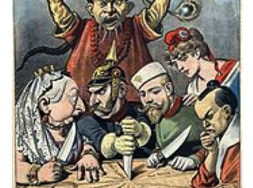
Civil Unrest Begins

Slide 33
The Last Emperor
Puyi was the last emperor
October 10, 1911, a new central government, the Republic of China under Sun Yat-sen formed.
Events followed that brought the end to the dynasties of China

