Slide 1
Beijing
1271 CE - 1911 CE

Slide 2
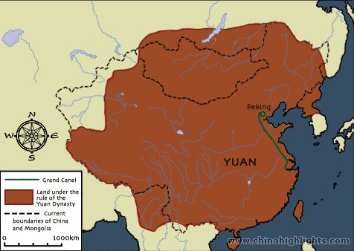
Yuan Dynasty & Beijing
Beijing was named the capital city in 1271 CE
As Beijing expanded it built more city structures

Slide 3
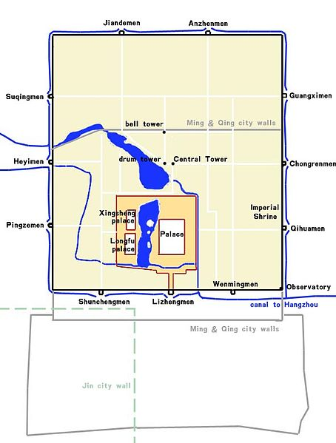
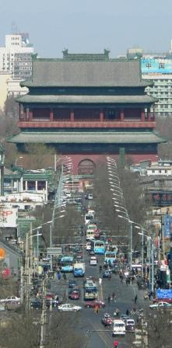
Grid Plan and Drum Tower

Slide 4
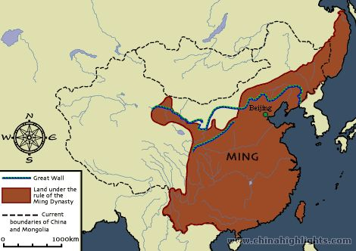
Ming Dynasty & Beijing
Founded in 1366, Beijing was named the capital of the Ming Dynasty
The Great Wall of China is extended and rebuilt
Many new structures were built during this time period

Slide 5
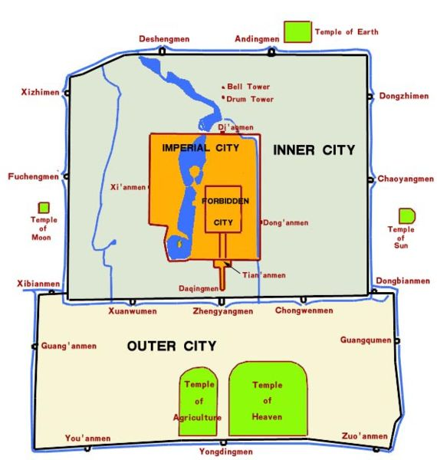
Layout of Beijing

Slide 6
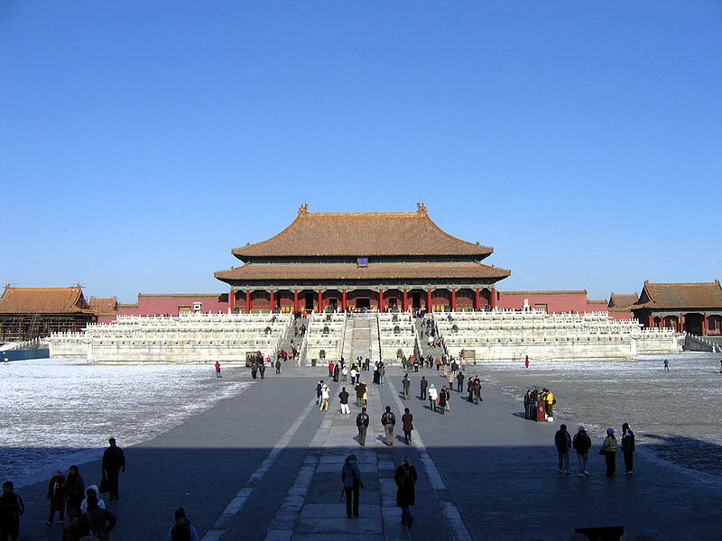
Forbidden City is Completed

Slide 7
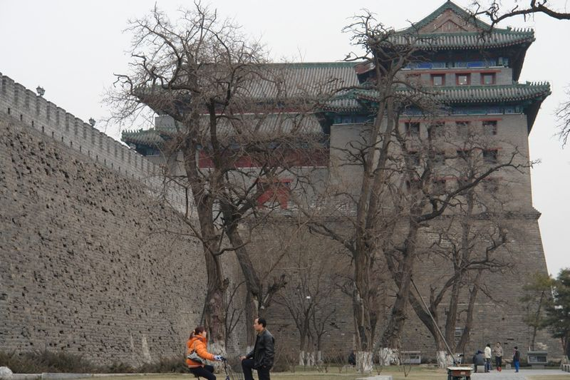
City Walls during Ming Dynasty

Slide 8
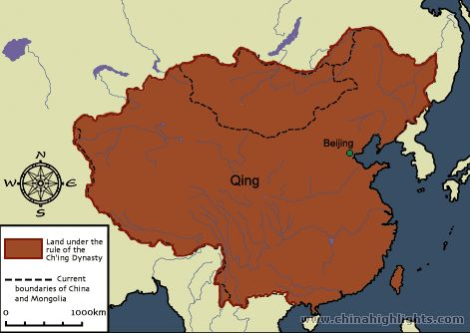
Qing Dynasty & Beijing
Founded in 1644 by the Manchu peoples from northeastern China, Beijing continued its run as capital of China
China would slowly modernize and change its layout. Notice how much bigger the city becomes in this dynasty

Slide 9
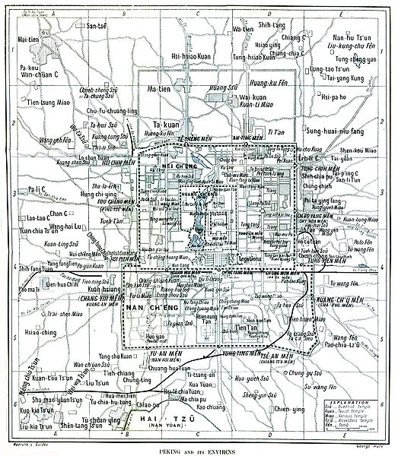
Grid Plan of Beijing

Slide 10
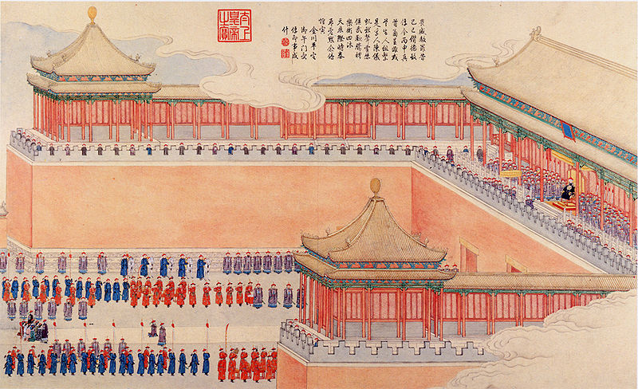
City Gates in Beijing

Slide 11
Panorama of Beijing

Slide 12
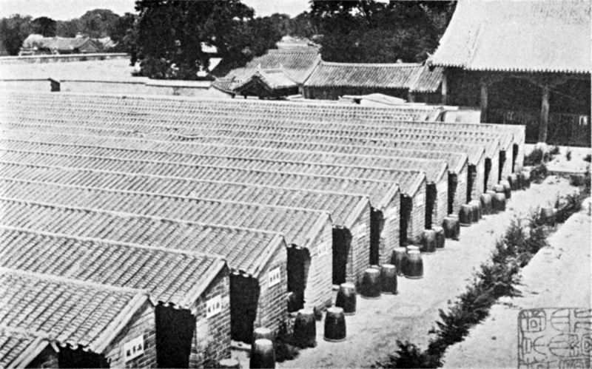
Civil Service Examination Buildings

Slide 13
General Trends
What did you notice about the city as it continued as the capital of China?
What buildings did you feel were added to help the people?
Which buildings were added to protect the people?
Why do you think cities grow?
What problems can occur when cities become too big or too crowded?

